Slide 1
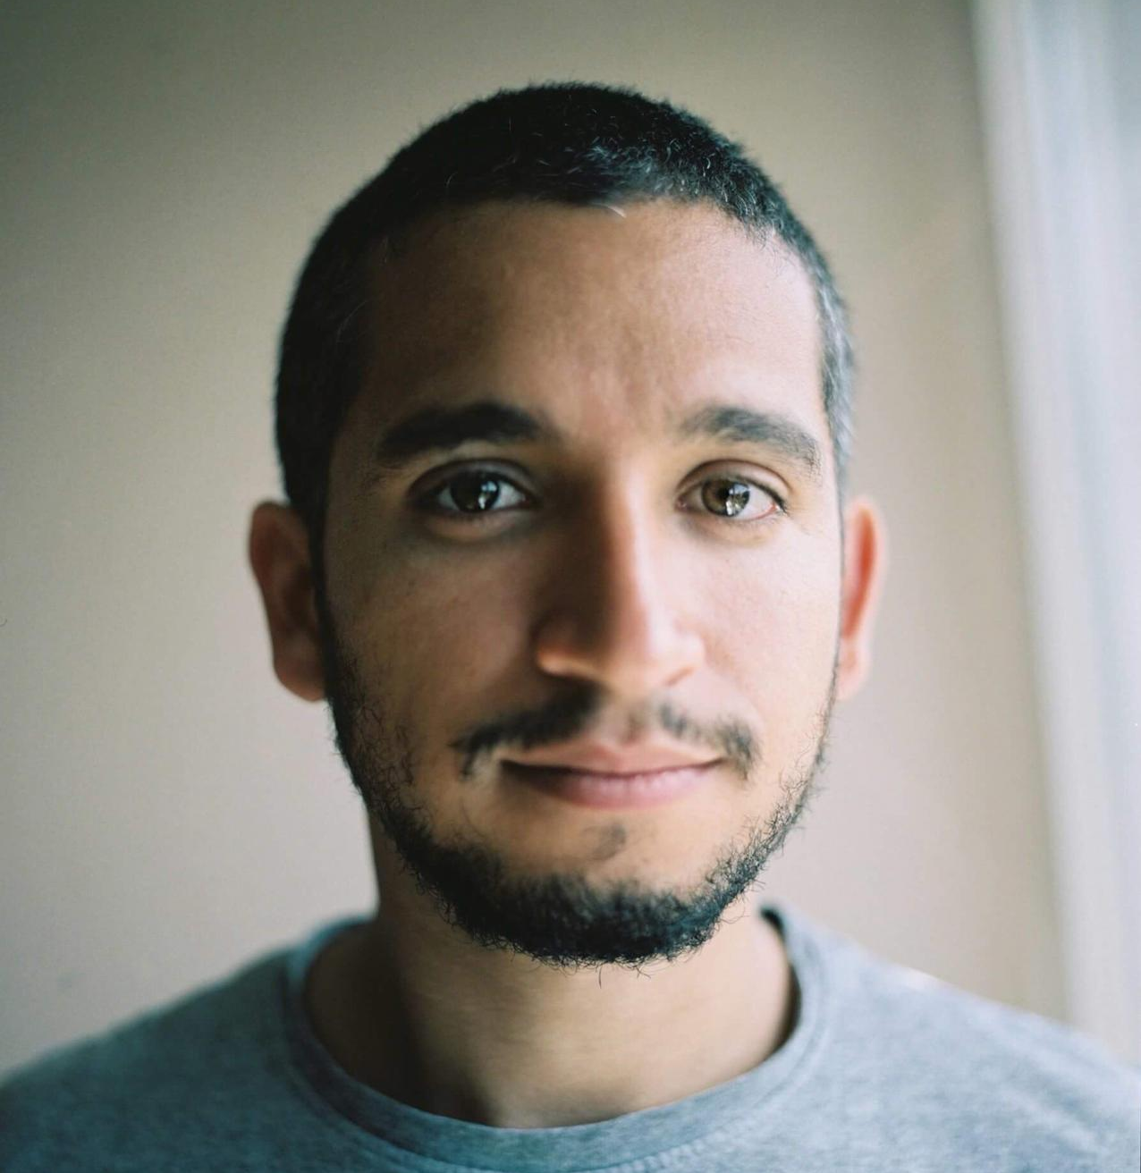



NAHEM SEGUIAS
BLOCKCHAIN DEVELOPER
SUMMARY
After working as a System Engineer for over 10 years, I wanted to expand my skill set to be able to work in more creative roles / projects.
In 2021 I took a sabbatical year to travel around the world, get better at different programming languages, master blockchain, and learn data analytics and finance.
One year later, I got a full time job in crypto as a smart contract developer using Rust in the Cosmos ecosystem.
WORK EXPERIENCE
Terraform Labs (Terra) – Remote. 2022-October
SMART CONTRACT DEVELOPER
- Use software development languages and tools to research, design, implement, manage, test, and evaluate software programs.
- Write, implement and test smart contracts in Rust & CosmWasm.
- Evaluate interfaces and develop specifications and performance requirements.
SIX (Swiss Stock Exchange) – Madrid. 2018-2022
SYSTEM ENGINEER
Troubleshoot escalated infrastructure issues.
Plan and execute configuration changes during maintenance windows.
Work on integration between stock exchanges.
Test brand new equipment before it is added to the network.
SICE (ACS Group) – Madrid 2017-2018
SYSTEM ENGINEER
Designed and implemented network solutions for Intellingent Traffic Systems.
Guaranteed seamless integration of network solutions with existing platforms.
Jump Trading (HFT) – London 2015-2017
NETOPS ENGINEER
Guaranteed optimal operation and availability of an ultra low-latency network.
Troubleshot complex infrastructure issues and fine-tuned the network in reaction to constantly changing markets.
Developed solutions to improve the way the network handled extremely high volumes of transactions in fractions of a second.
Cambridge Broadband Networks – Cambridge 2013-2015
CUSTOMER SUPPORT ENGINEER
Provided high-level customer support to clients worldwide.
Designed wireless network solutions for clients to interconnect remote areas.
Created, maintained, and improved business relationships with customers.
BLOCKCHAIN
- Smart Contract development
- PoW mining infrastructure
- DeFI: yield farming, staking, nodes
- Web3: NFT, DAO, ENS, wallets
- Co-founder and speaker of Criptopedia
- Different consensus mechanisms
- MEV, flashbots
- Ethereum scaling solutions.
- Security best practices
TECH SKILLS
- Financial Markets & Crypto
- Rust, CosmWasm, Python, Solidity
- Automation
- Machine Learning & AI
- Algorithmic Trading
- Data Analytics & visualization.
- Cloud: AWS, Azure, and GCP
- Routing & Switching
EDUCATION
Madrid Stock Exchange – Madrid, Spain 2021 – Incomplete
MSC IN AI FOR FINANCIAL MARKETS
- Trading Strategies & Algorithms.
- Cloud Computing for Big Data.
- Deep Learning & Neural Networks.
- Blockchain.
360 GSP College – London, UK 2013-2014
SERVER ADMIN & CUSTOMER SUPPORT
- Cisco CCNA, Microsoft MCSA, and VMWare training.
Universidad Catolica Andres Bello – Caracas, Venezuela 2005-2011
MSC IN TELECOMMUNICATION ENGINEERING
- Graduated with honours.
- Top 5% of the class.
CONTACT
Skype
nahem.seguias.ferrero
Mobile
+34 665 780 125
Email
nahemseguias@gmail.com
Linkedin
www.linkedin.com/in/nseguias

